Slide 1
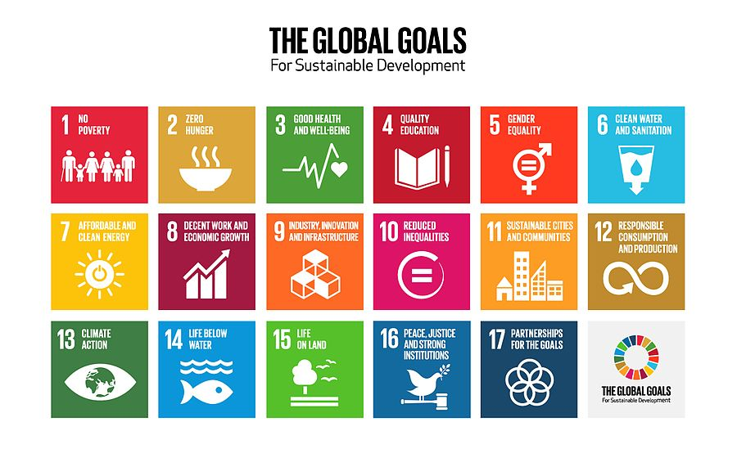
BAMBOO BASED ENTREPRENEURSHIP DEVELOPMENT
Anuj Sharma, Executive Director, Somaiya Properties & Investment Pvt Ltd

Slide 2
ABOUT MYSELF
Agroforestry & sustainable development professional with over ten years of experience.
Alumni of Indian Institute of Forest Management, Bhopal.
Successfully implemented projects in Natural resource management, Landscape restoration, Ecotourism & Bamboo resource augmentation.
Previously worked in MP Forest Department, National Highways Authority of India & a bamboo based startup – Artison Agrotech Pvt Ltd
Currently handling agroforestry operations of Somaiya Group on their 2400 acre farm.

Slide 3
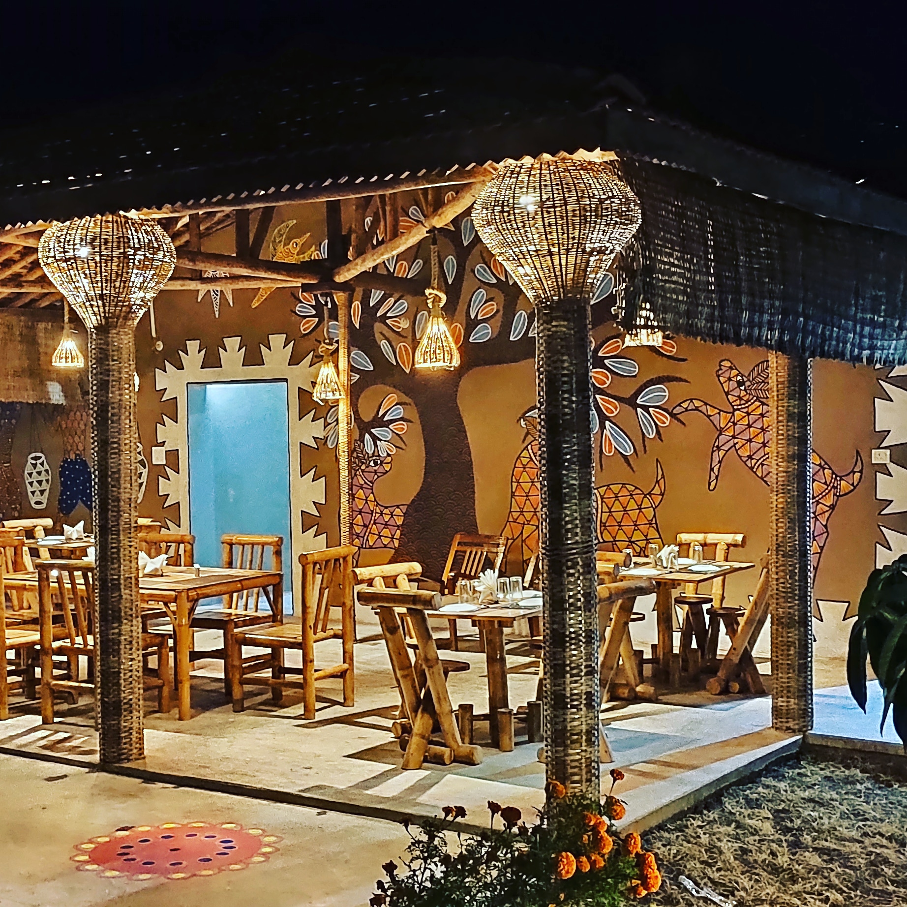
My experiments with Bamboo (Part – 1)
Bamboo has always fascinated me as a sustainable construction material.
It has an unique aesthetic appeal, gels with any construction material

Slide 4
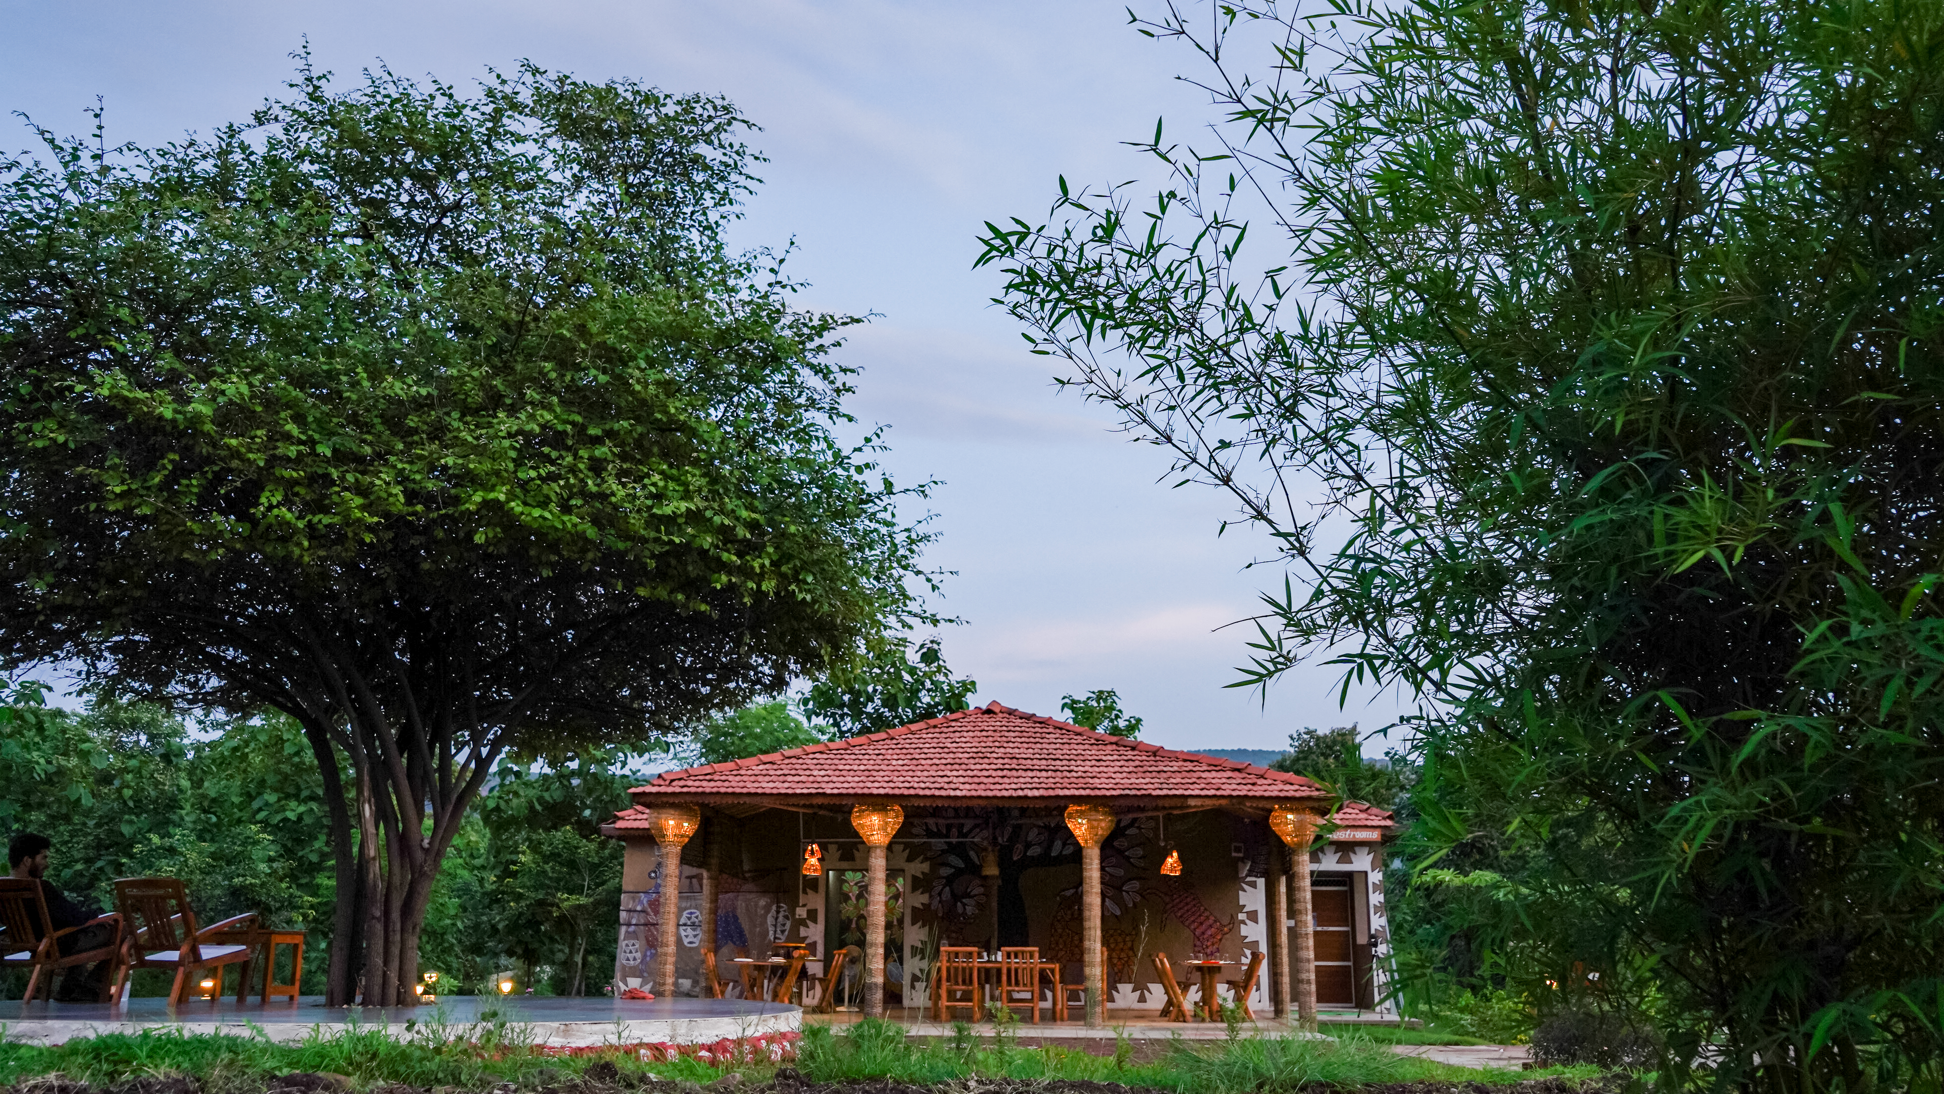

Slide 5
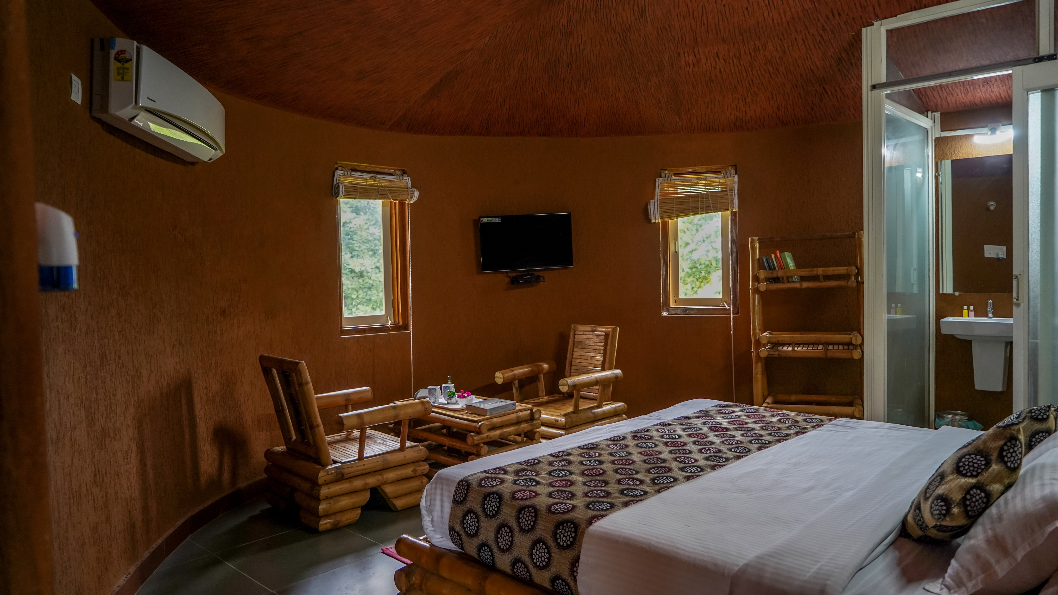

Slide 6
Treatment of Bamboo
Onsite Treatment Pool: 20 % V/V Concentration of Boric –Borax Solution
Vacuum Impregnation Unit for treatment

Slide 7
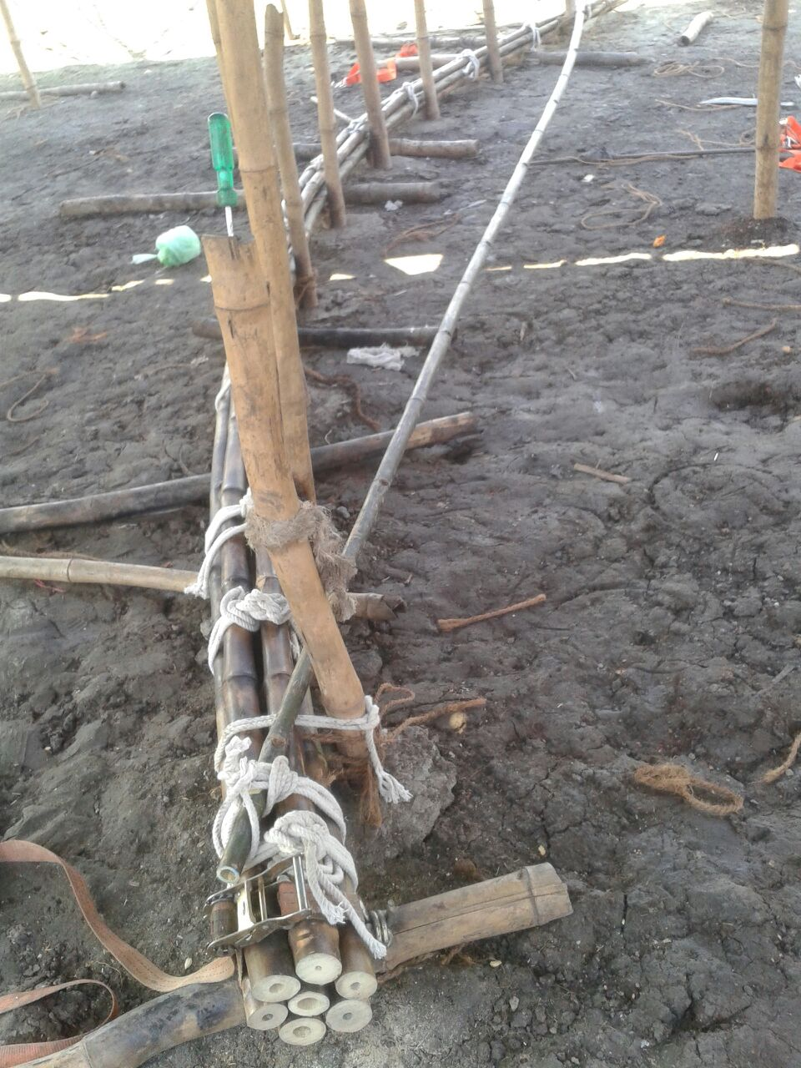
Bending & Bundling of Bamboo
Heat Bending: to bend bamboo by applying heat
Bundling of Bamboo: To be utilized as Columns for Bamboo Cottage

Slide 8
Erection of Bamboo Structure

Slide 9
Exteriors of Bamboo Cottages

Slide 10
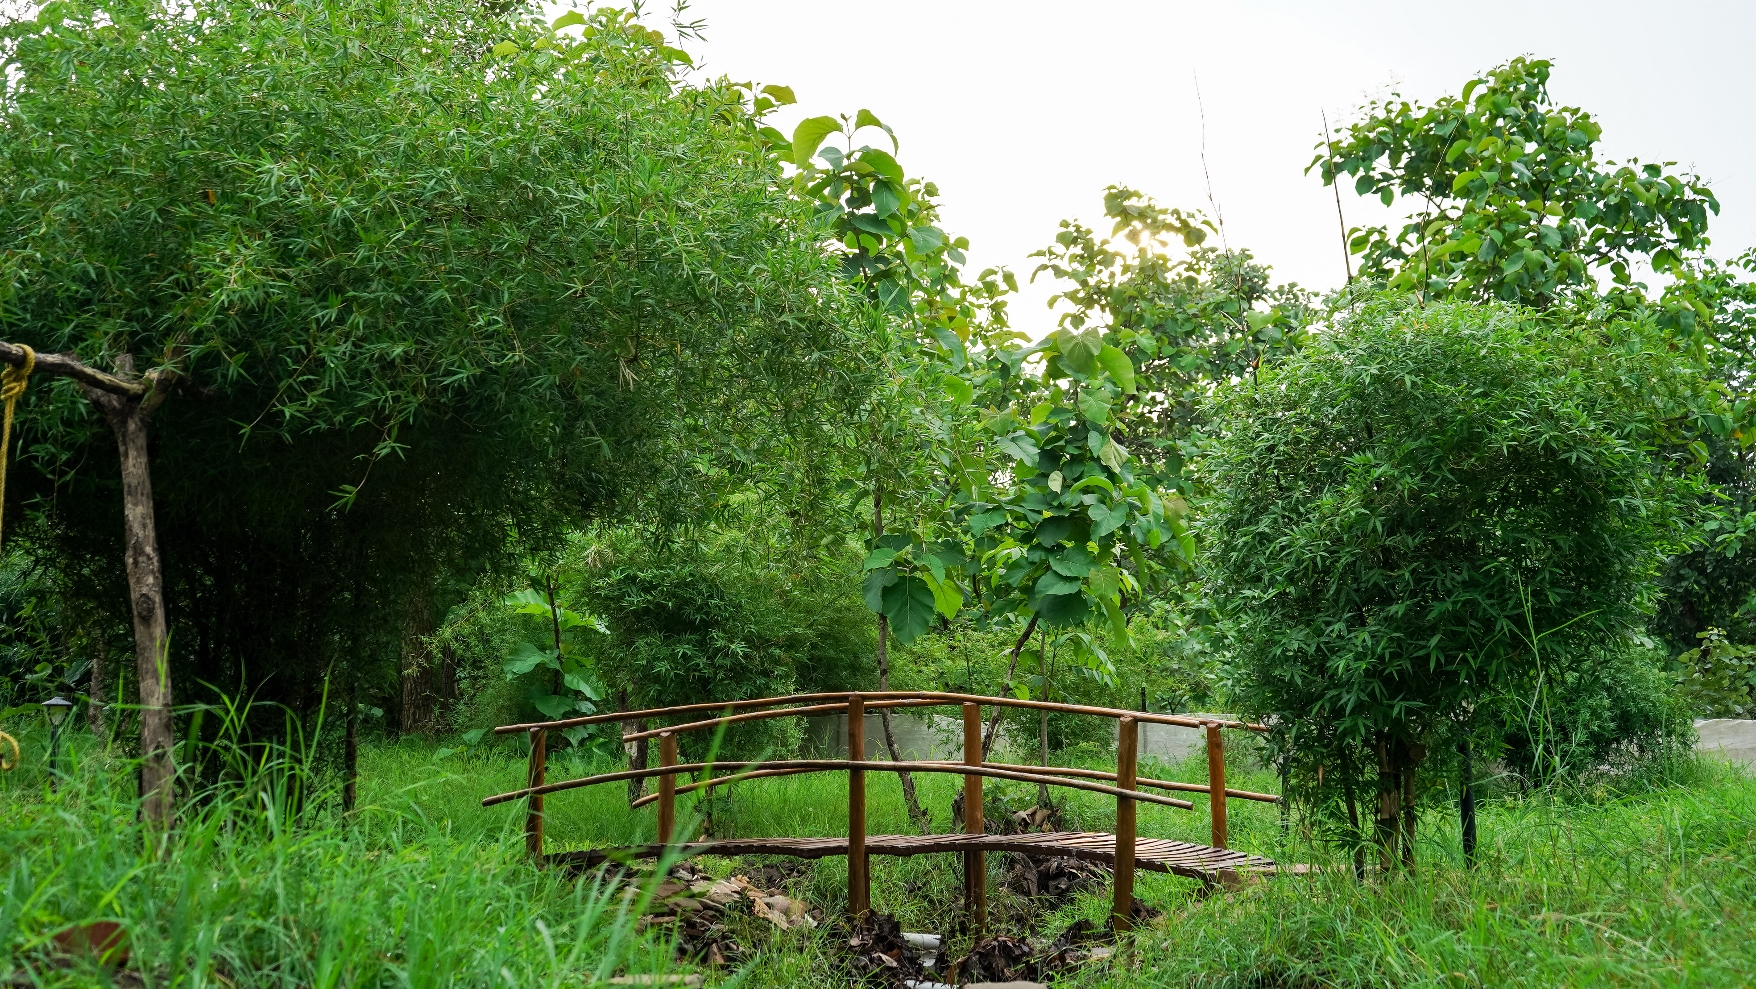
My experiments with Bamboo (Part -2)
Bamboo is one of the best species for plantations for landscape development
It grows fast, remains green most of the year
Procured at a lower cost as compared to contemporary ornamental plants

Slide 11
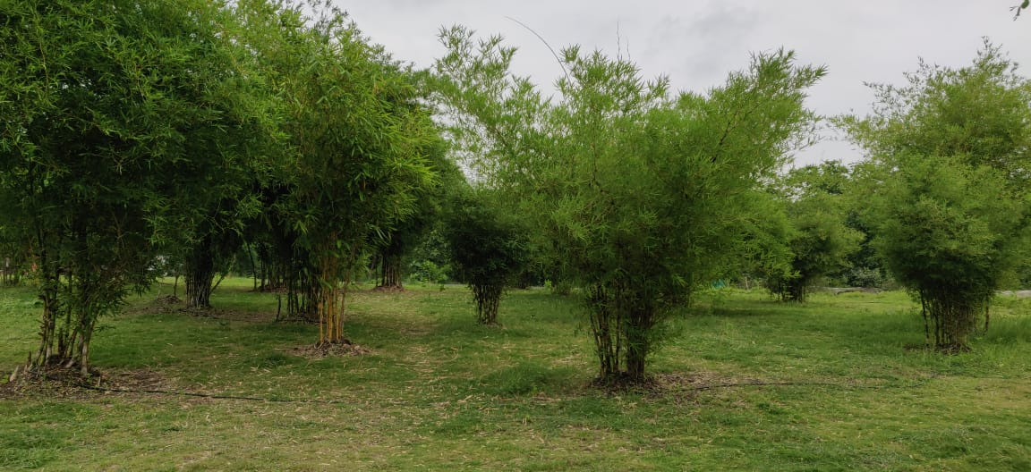

Slide 12
My experiments with Bamboo (Part -3)
Bamboo is the best species for plantations along riverside, rivulets and fallow lands
Helps in soil-water conservation

Slide 13
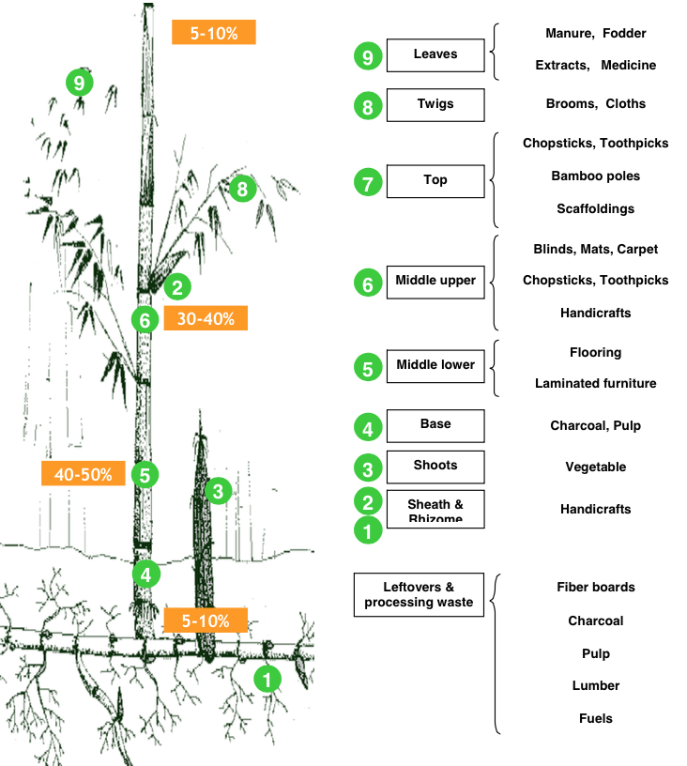
Learnings
Bamboo serves the most ordinary as well as the most refined purposes
Every part of bamboo has unique utility.
Which makes it the most robust and versatile crop/raw material.

Slide 14
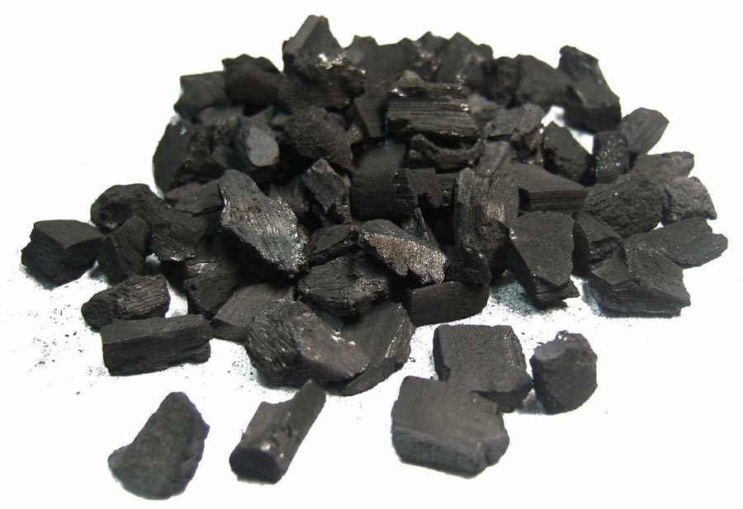
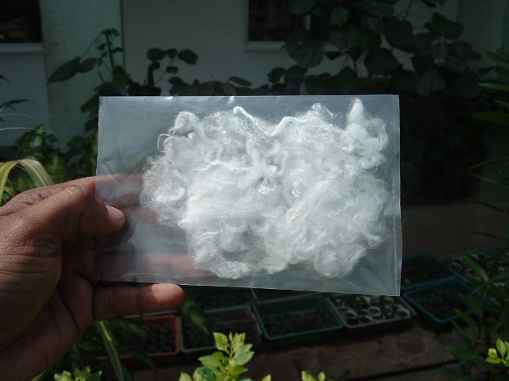
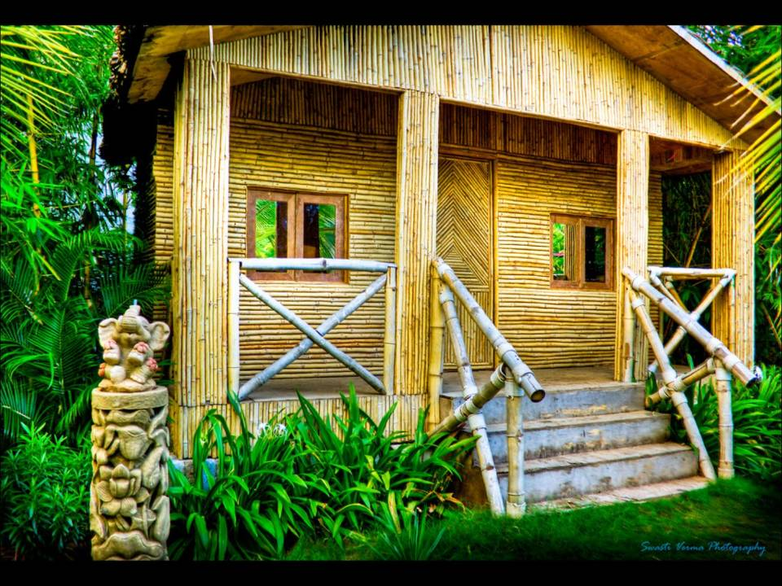
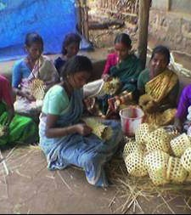
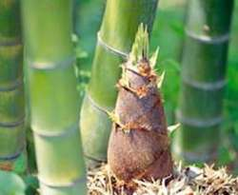
Areas for Bamboo based Entrepreneurship Development
Bamboo
Economy
Farming
Bio-energy Industry
Furniture industry
Building Industries
Pulp & Paper Industry
Textile Industry
Craft Industry
Food and Beverage Industry

Slide 15
Gaps that may be filled by entrepreneurs
Where we stand vis a vis China
India is well endowed with resources of bamboo, the second largest in the world
The world trade in bamboo is currently estimated at 14 billion dollars every year.
Indian bamboo industries has a size of Rs. 2040 crore/ year at present, while the domestic market potential is 4463 crore.
Ref – Planning Commission Document
Parameter | China | India
Bamboo Area (lakh ha) | 54 | 113.6
Production (no of culms - crore) | 123 | 125
Revenue – annual (Crore INR) | 1,17,000 | 10,000
Jobs (Number) | 350 lakh | 86000
Households (Number) | 126 lakh | 21500
Average productivity (tons/ha/year) | 20 | 2
Share in global market | 67% | 6%

Slide 16
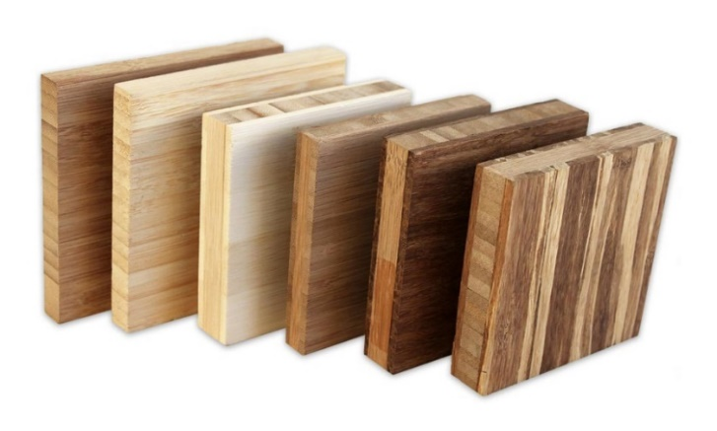
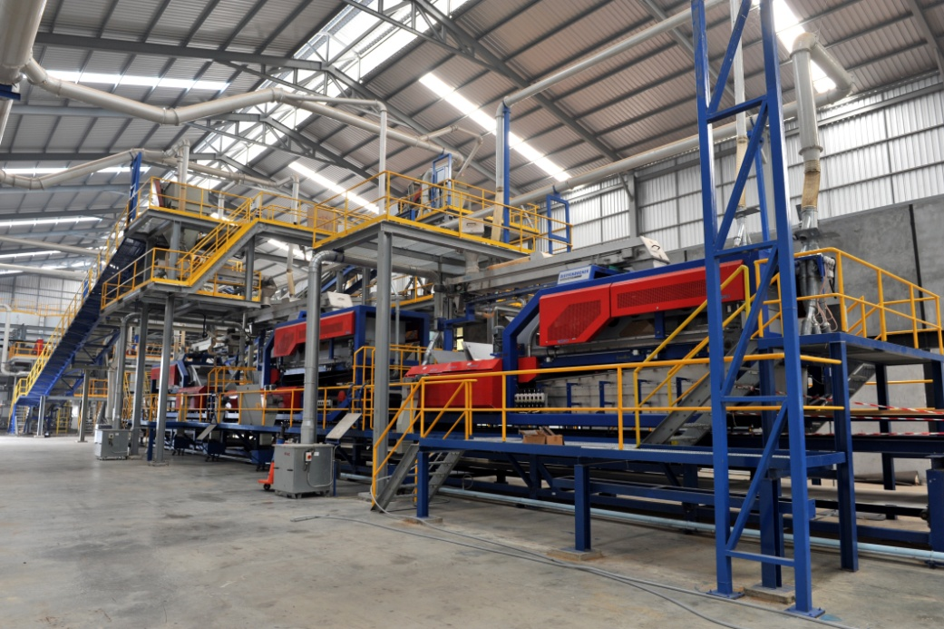
Issues hindering growth of Bamboo sector in India..
Advancement of technology has not reached regional and rural level
processing units, post harvest management & logistic management are cause of concern.
Bamboo wastage at MSME level is very high
Economies of scale still an issue

Slide 17
Issues hindering growth of Bamboo sector in India..
Non uniform spread of skilled artisans in India.
Planning with present perspective will not work for future challenges
We still think of bamboo in present context whereas entrepreneurs should plan and develop their ideas for its utility 10 years from now.
The ideal questions to ask will be
where will my product offering fit ten years down the line.
Is my business model flexible enough to accommodate change in technology

Slide 18
Recommendations for strengthening Bamboo Sector in India..
Establishment of Bamboo Incubation Centre in three levels National, State level and Regional level
Facilitating STARTUPs and MSMEs in
Legal structuring
Learning from peers
Logistics support
National
State-1
Regional -2
Regional -2
State -2
Regional -1

Slide 19
Recommendations for strengthening Bamboo Sector in India..
Bamboo Resource Augmentation:
Genetic improvement of the existing species and introduction of new species for different agro climatic zone.
Establishment of High tech integrated germ-plasm bank & tissue culture lab at every state level for mass production of high quality seedlings/saplings.
Restoration of wasteland and degraded lands through bamboo plantations.

